Slide 1
Orlando Crimes
Orlando is a famous holiday destination for families. It will be good to understand the crime pattern so that police officers can proactively monitor these areas for a particular crime.

Slide 2
Police Data Initiative
The Police Data Initiative is a open data repository and it promotes the use of the data to encourage joint problem solving, innovation, enhanced understanding, and accountability between communities and the law enforcement agencies that serve them. There are many city data available here but I used Orlando crime data for the analysis.
Link to the data: https://data.cityoforlando.net/

Slide 3
Orlando Crime Data
Total number of observations with latitude and longitude values: 172
Columns considered for the analysis
Case Number
Offense Category
Offense Location Type
Latitude
Longitude
Data set is enhanced with Four square data

Slide 4
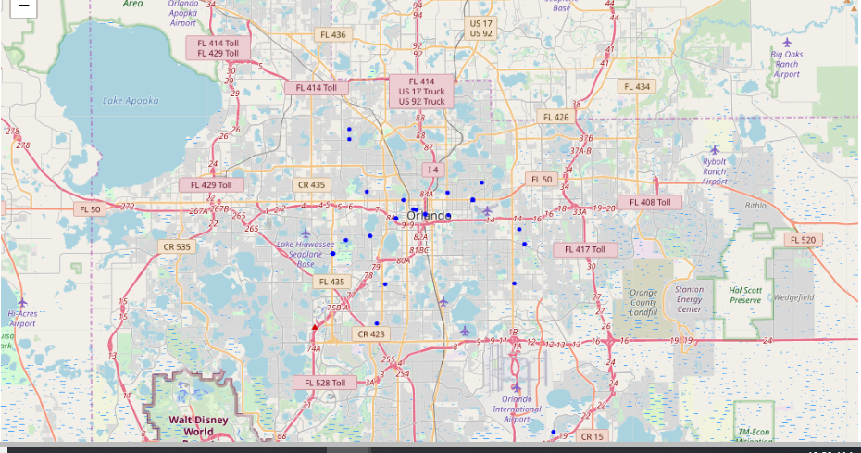
Crime data mapped

Slide 5
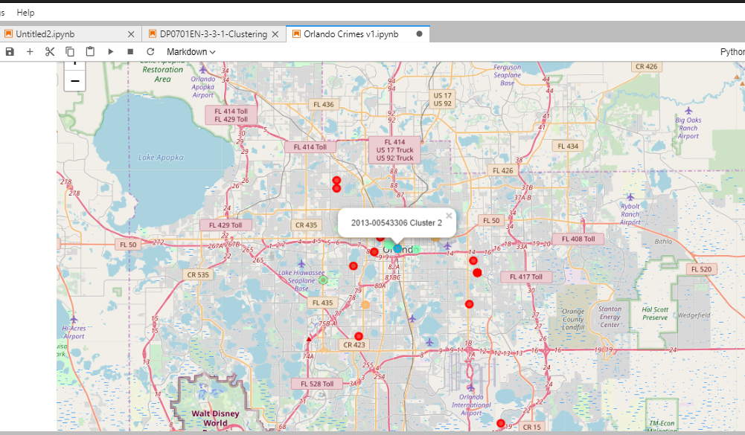
Map of the clusters

Slide 6
Results and Observation
Crimes occurred in Cluster 1 areas show that crime is happening most often next to ice cream shop followed by Bakery.
Cluster 3 also show that Theft most often occurs next to ice cream shop and bakery. Rest of the clusters have fewer observations.
Current data set has limited crime data which maybe biased towards certain crimes (For example Theft). Having additional data would be more useful for analysis. Also having data with non-crime incidents would be useful for additional analysis.

